Slide 1


Winning Space Race with Data Science
Muhammad Aamer
July 27, 2023

Slide 2






Outline
Winning Space Race with Data Science
Executive Summary
Introduction
Methodology
Results
Conclusion
References

Slide 3

Executive Summery
Summary of Methodologies
Data Collection via API and Web Scraping
Data Wrangling
Exploratory Data Analysis (EDA) with SQL
EDA with Data Visualization
Building a Data Visualization (map) with Folium
Building an Interactive Dashboard with Plotly Dash
Predictive Analysis (Classification)
Summary of All Results
EDA results
Interactive Maps and Dashboard
Predictive results

Slide 4
Introduction
Project background and context
The purpose of this project is to predict if the Falcon 9 first stage with land successfully.
SpaceX advertises on its website that Falcon 9 rocket launches with a cost of 62 million dollars when other providers cost upward of 165 million dollars each.
This is because SpaceX can reuse the first stage. Therefore, if we can determine if the first stage will land, we can determine the cost of a launch.
Problems you want to find answers
What are the factor for successful landing?
What are the relationship between each variables on success landing result?
What are the condition that will allow SpaceX to achieve the best landing success rate?

Slide 5
Section # 1
Methodology

Slide 6
Methodology
Executive Summary
Data collection methodology
SpaceX REST API, Web Scrapping from Wikipedia
Perform data wrangling
Dropping unnecessary columns, One Hot Encoding for classification model
Perform Exploratory Data Analysis (EDA) using Visualization and SQL
Perform Interactive Visual Analytics using Folium and Plotly Dash
Perform Predictive Analysis using Classification Models
Models have been built, tune, evaluate for the best classification models

Slide 7
Data Collection
Data sets were collected from two sources
SpaceX API, using HTML GET requests and parsing the JSON responses
Web-scraping Wikipedia data on Falcon9 launches, using HTM GET request and parsing webpage using Beautiful-Soup objects.
More description are provided in the next slides

Slide 8
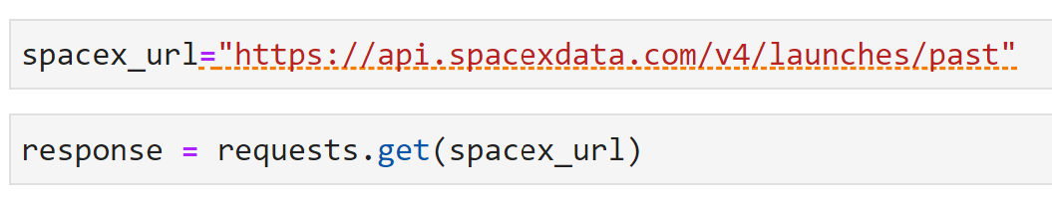
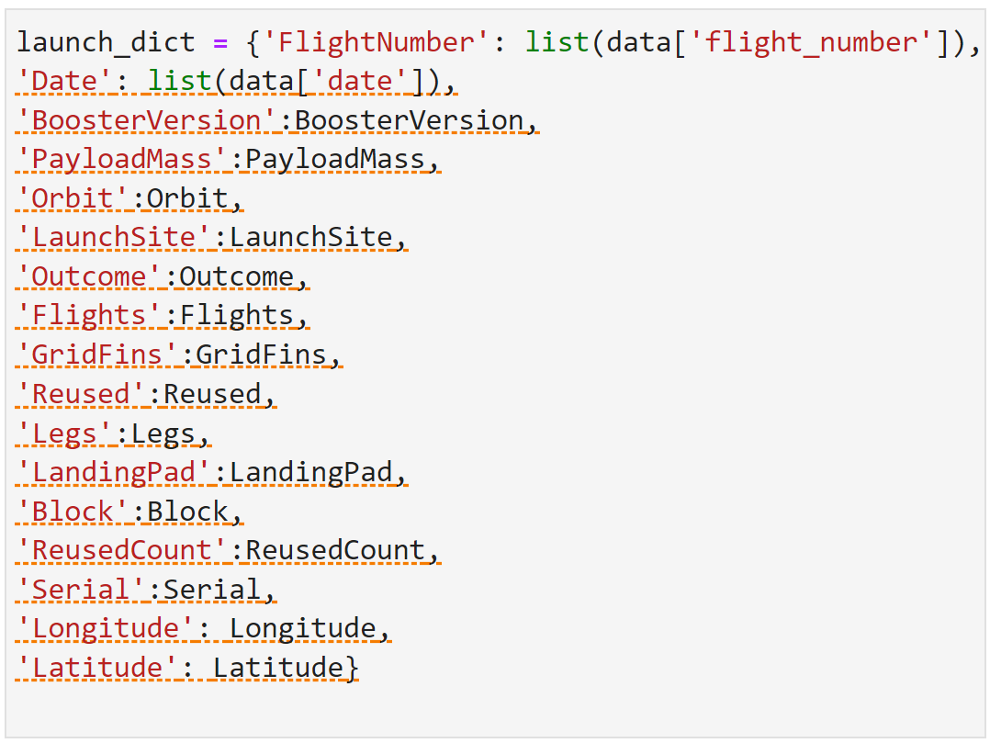
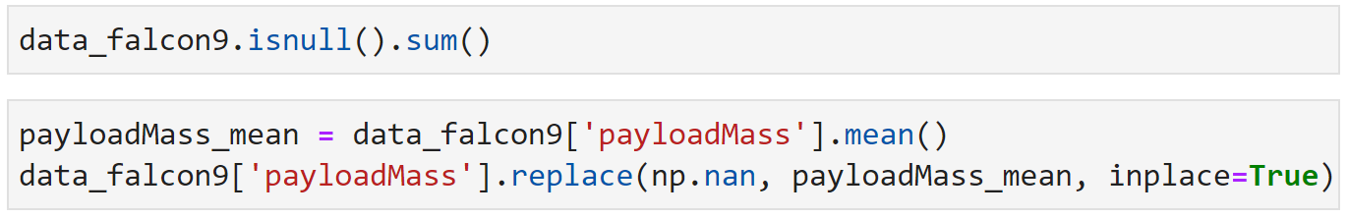
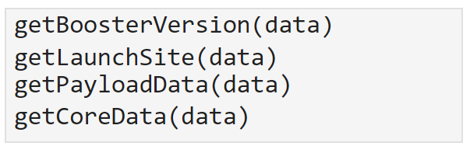
Data Collection-SpaceX API
In addition to SpaceX API, data has been scraped from a Wiki page on Falcon 9 launches and translated into Panda's data frame using Beautiful Soup library.
Getting Respond From API
Convert Response to JSON File
Data Transforming
Dictionary and Dataframe Creation
Dataframe Filtration
Dealing with Missing Values
Export data to CSV File
Dataframe Creation
For the completed notebook Click here

Slide 9
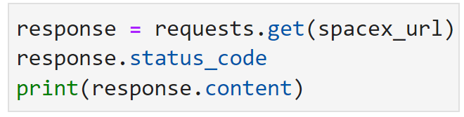
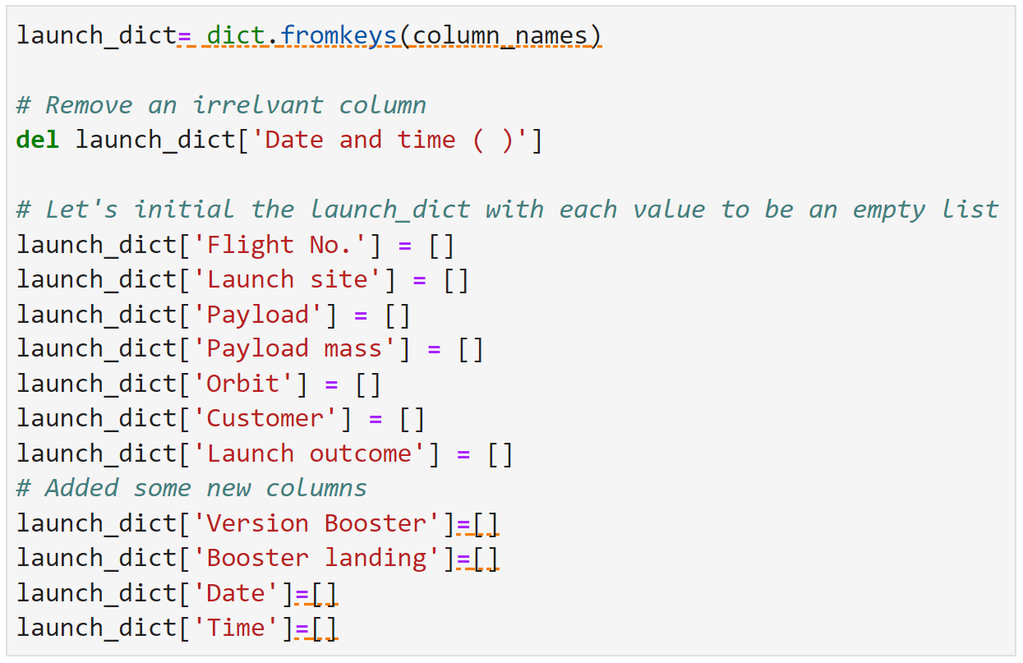
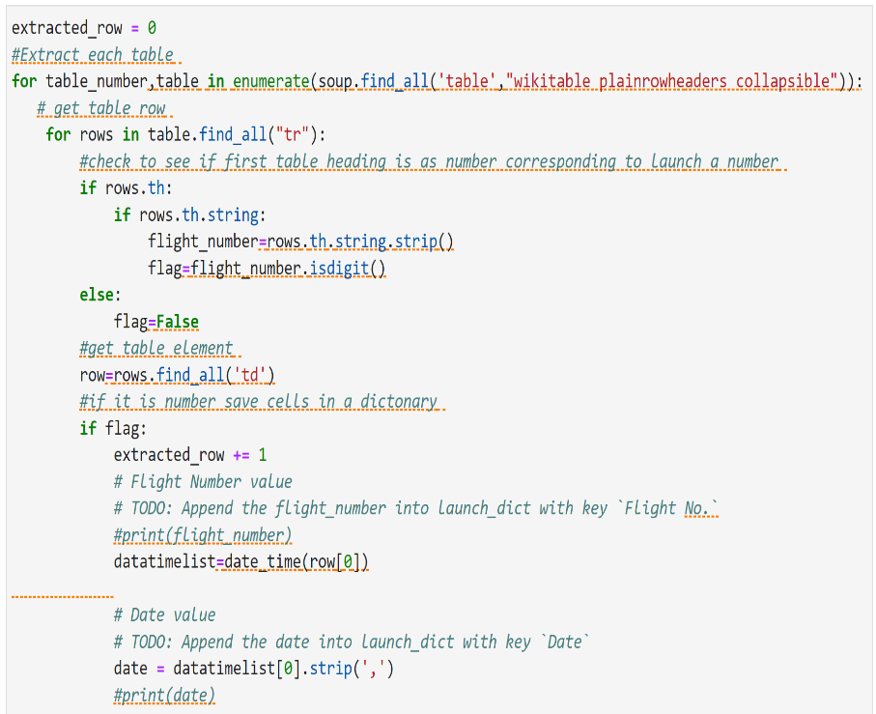
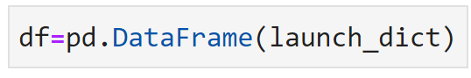
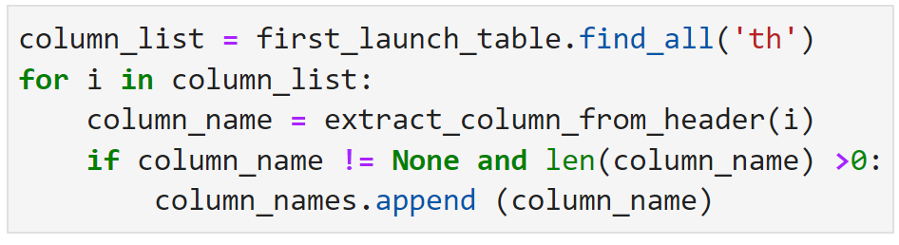
Data Collection-Scraping
In addition to SpaceX API, data has been scraped from a Wiki page on Falcon 9 launches and translated into Panda's data frame using Beautiful Soup library.
Getting Respond From HTML
Beautiful-Soup Object Creating
Finding Tables
Dictionary Creation
Adding Data to Keys
Dataframe Creation
Export data to CSV File
Get Column Names
For the completed notebook Click here

Slide 10
Data Wrangling
Data was processed to understand its quality and create appropriate training labels, as follows
Missing values across each attribute in the dataframe were identified
Missing values in column Payload Mass were replaced with mean of the column values
Type of each attribute in the frame was verified
A new attribute has been created in the dataframe to indicate whether landing has been successful or not ("class", with value of O for unsuccessful landing and 1 for successful)
Complete data warngling notebook can be found from the ling. (Wrangling)

Slide 11
EDA with Data Visualization
Following charts were plotted during EDA with Data Visualization stage
See how continuous launch attempts and payload affect the outcome- using scatterplotof Flight Number versus PayloadMass, overlaid with outcome of the launch
Visualize relationship between flight number and launch site, and the outcomes of launch - using scatterplot of FlightNumber versus LaunchSite, overlaid with outcome of the launch
Inspect relationship between payload and launch site, and the outcomes of launch - using scatterplot of PayloadMass versus LaunchSite, overlaid with outcome of the launch
Visualize the relationship between success rate of each orbit type - using barplot of Orbit versus class
check if there are any relationship between success rate and orbit type - using barchartf or the success rate of each orbit
Find orbits that have high success rate - scatterplot of FlightNumber versus Orbit type, overlaid with outcome of the launch
Inspect relationship between payload and orbit type - scatterplot of PayloadMass versus Orbit type, overlaid with outcome of the launch
Visualize the launch success yearly trend - lineplot of launch year versus success rate
For the completed notebook Click Here

Slide 12
EDA with SQL
Following queries have been run as part of exploratory data analysis with SQL:
Names of the unique launch sites in the space mission
Five sample records where launch sites begin with the string 'CCA’
3. Total payload mass carried by boosters launched by NASA (CRS)
Average payload mass carried by booster version F9 v1.1
Date when the first successful landing outcome in ground pad was achieved
Names of the boosters which have success in drone ship and have payload mass greater than 4000 but less than 6000
Total number of successful and failure mission outcomes
Names of the booster versions which have carried the maximum payload mass
Month names, failure landing outcomes in drone ships, booster versions and, launch sites by month for year 2015
Successful landing outcomes between 04-06-2010 and 20-03-2017, sorted in descending order
For the completed notebook Click here

Slide 13
Build an Interactive Map with Folium
Folium map object is a map centered on NASA Johnson Space Center at Hooson, Texas
Blue circle at NASA Johnson Space Center's coordinate with label showing it name, using folium. Circle and folium.map.Marker
Red circles at each launch site coordinates with label showing launch site name, using folium. Circle, folium.Marker and folium.features.Divlcon
Grouping of points in a cluster to display multiple and different information for the same coordinates, using MarkerCluster
Markers to show successful (green) and unsuccessful (red) landings, using folium.Marker and folium.lcon
Add mouse position on the map to get coordinate for a mouse over the point on the map, using MousePosition
Markers to show distance between launch site to key location (coastline, railway, highway and city) using folium.Divlcon, folium.map.Marker and folium.Polyline
These objects are created in order to understand better the problem and the data.
For the completed notebook Click Here

Slide 14
Build a Dashboard with Plotly Dash
Dashboard contains the following plots/graphs and interactions:
Dropdown which allows a user to choose the launch site or all launch sites (dash_core_components.Dropdown)
Pie chart which shows the total success and the total failure for the launch site chosen with the dropdown component (plotly.express.pie)
Rangeslider which allows a user to select a payload mass in a fixed range (dash_core_components.RangeSlider)
• Scatter chart which shows the relationship between two variables, in particular Success vs Payload Mass (plotly.express.scatter)

Slide 15
Predictive Analysis (Classification)
• Data Preparation
Load dataset
Normalize data
Split data into training and test sets
• Model Preparation
Selection of machine learning algorithms
Set parameters for each algorithm to GridSearchCV
Training GridSearch Model with training dataset
• Model Evaluation
Get best hyperparameters for each type of model
Calculate accuracy for each model with test dataset
Plot Confusion Matrix
• Model Comparison
Comparison of models according to their accuracy
The model with the best accuracy will be chosen

Slide 16



Results
Exploratory Data Analysis Results
Interactive Analytics Demo in Screenshots
Predictive Analysis Results

Slide 17
Section # 2
Insights Drawn From EDA

Slide 18
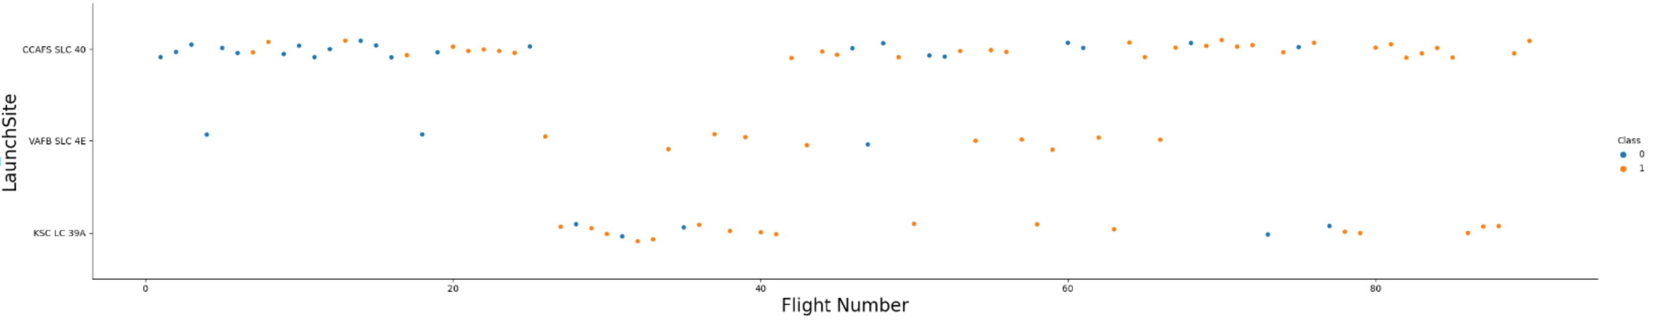
Flight Number vs. Launch Site
For each site, the success rate is increasing.

Slide 19
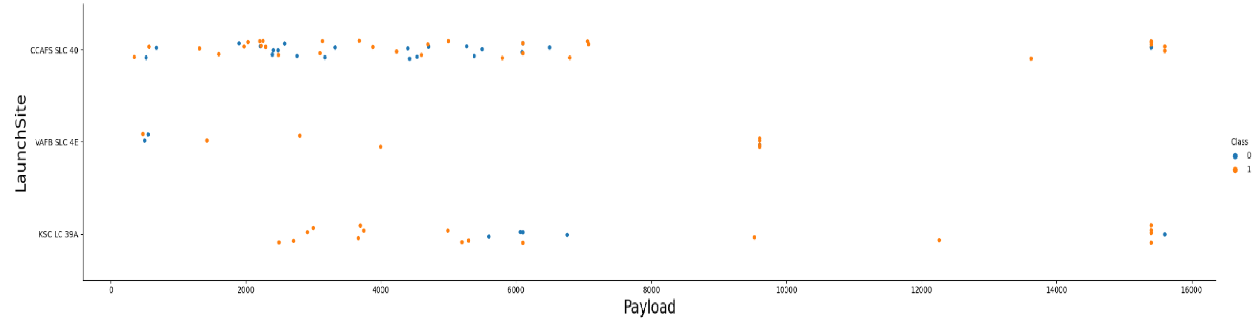
Payload vs. Launch Site

Slide 20
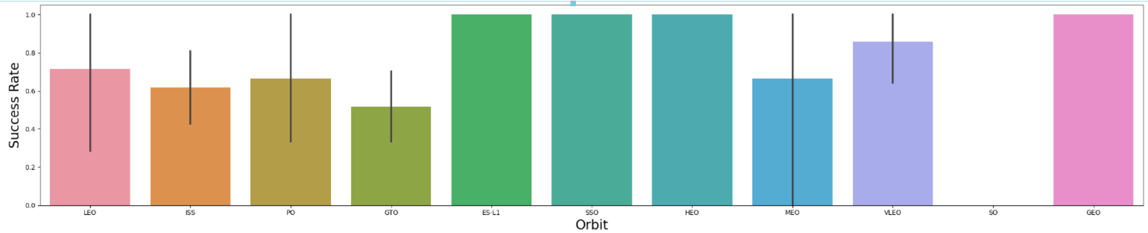
Success Rate vs. Orbit Type
The Orbit Type ES-L1, GEO, HEO and SSO have high success rate.

Slide 21
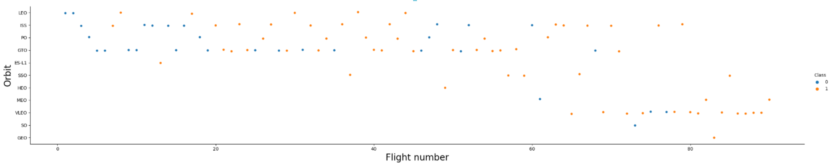
Flight Number vs. Orbit Type
The success in the LEO orbit appears related to the number of flights, on the other hand, there seems to be no relationship between flight number when in GTO orbit.

Slide 22
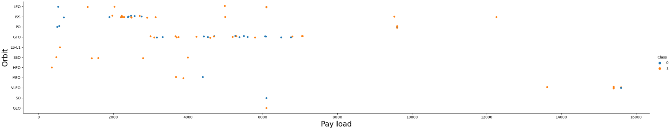
Payload vs. Orbit Type
There are more successful landing rate with heavy payloads for Polar, LEO and ISS orbits.

Slide 23
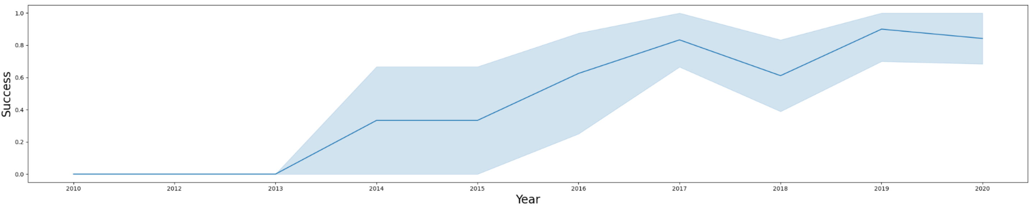
Launch Success Yearly Trend
The success rate kept increasing since 2013 till 2020.

Slide 24
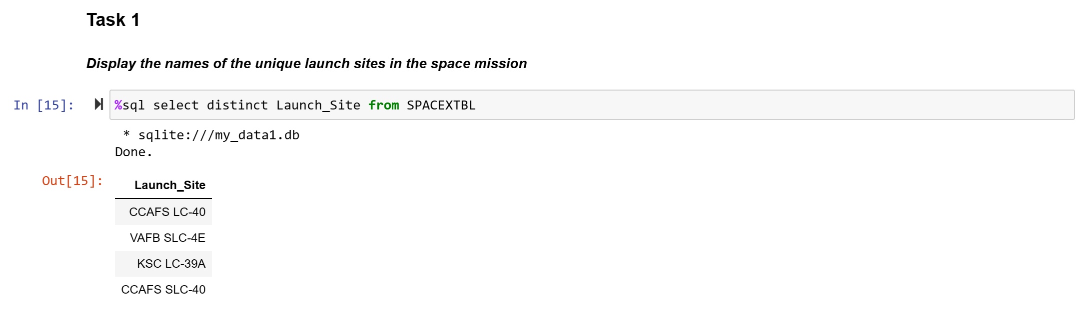
All Launch Site Names
Using distinct in query can get unique value

Slide 25
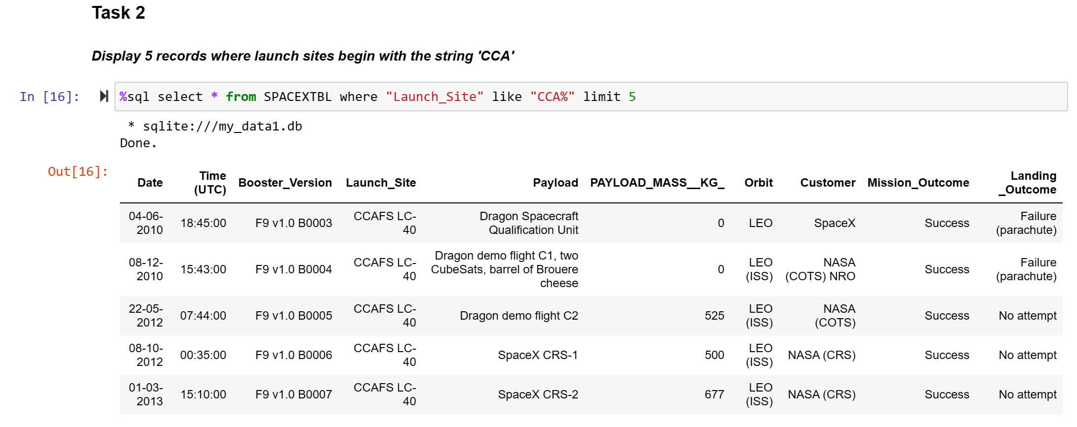
Launch Site Names Begin with ‘CCA’
where function followed by like function filters launch sites that contain substring CCA
Limit 5 for showing 5 rows of record

Slide 26
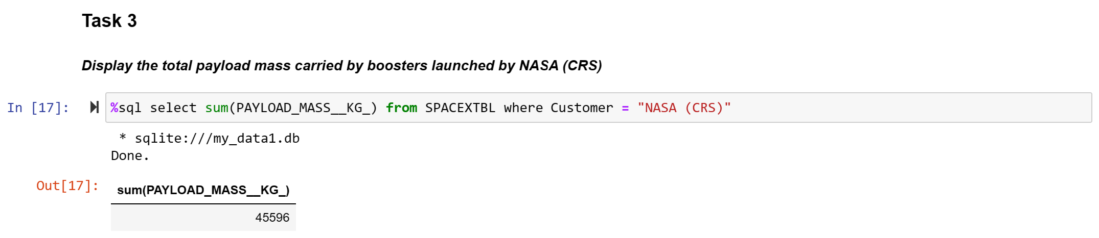
Total Payload Mass
Using SUM to get the sum of all payload masses and using WHERE function to get customer in NASA (CRS).

Slide 27
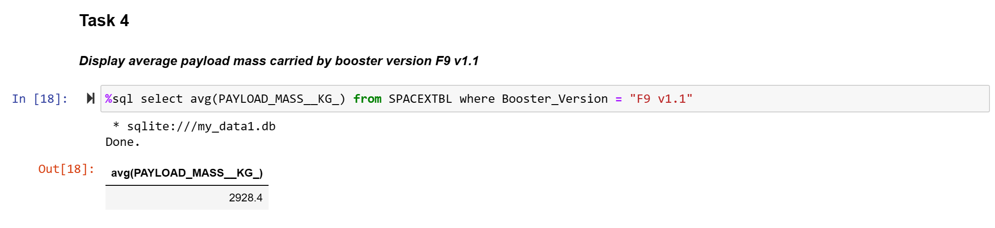
Average Payload Mass by F9 v1.1
Using AVG returns the average of all payload masses where the booster version contains the substring F9 v1.1

Slide 28
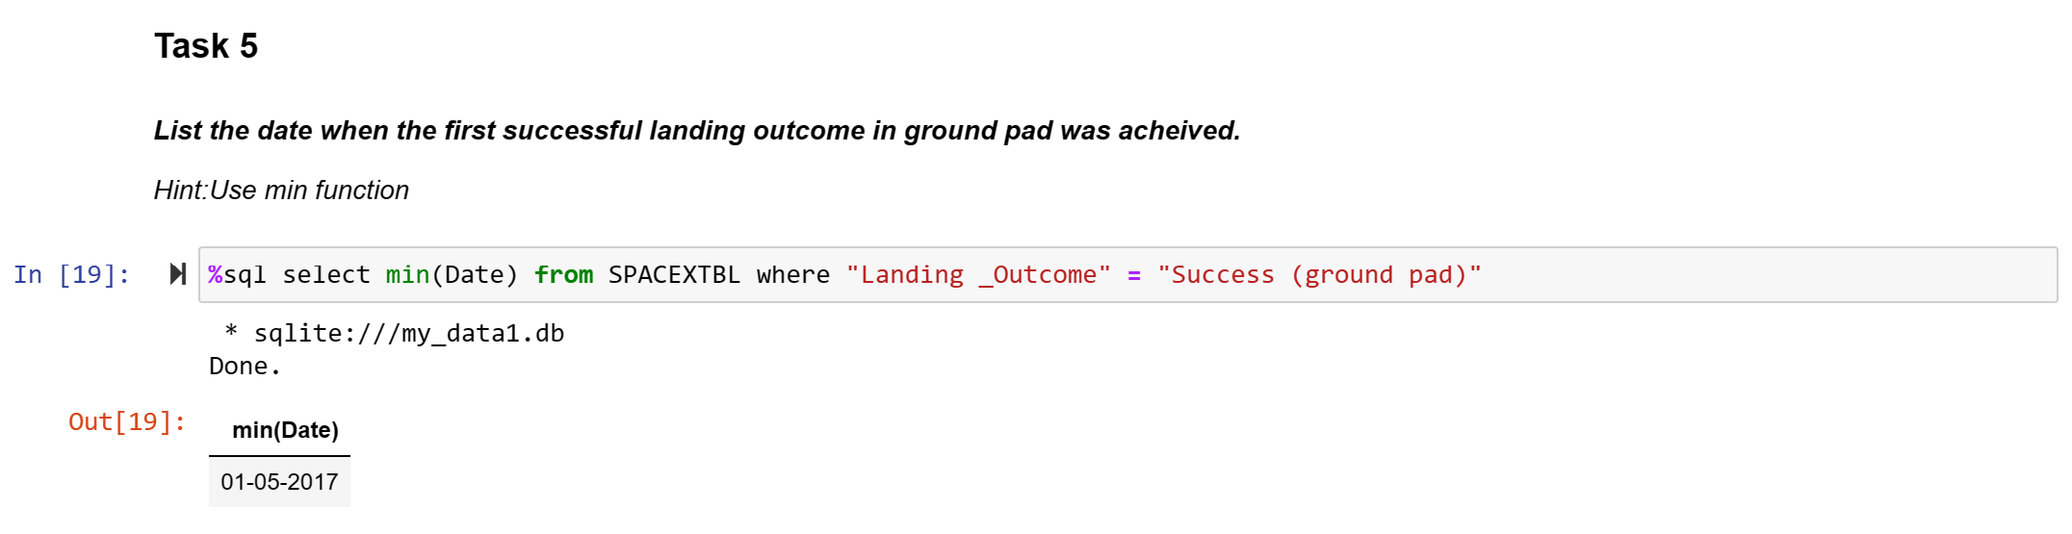
First Successful Ground Landing Date
To get the first successful date by using min because the first date is the same with the minimum date.

Slide 29
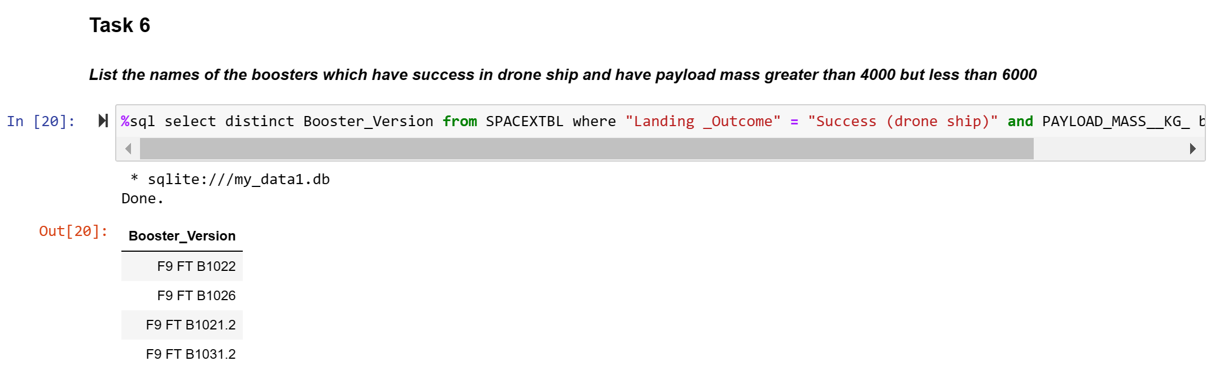
Successful Drone Ship Landing with Payload between 4000 and 6000
WHERE and AND function filter the dataset which is the booster version where landing outcome was successful and payload mass is between 4000 and 6000 kg.

Slide 30
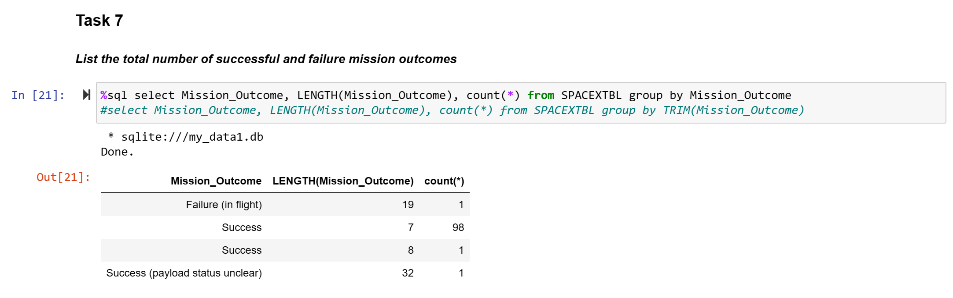
Build a Dashboard with Plotly Dash
COUNT function in conjunction with GROUP BY characterize data under various groupings. A combination of same values (on a column) will be treated as an individual group.

Slide 31
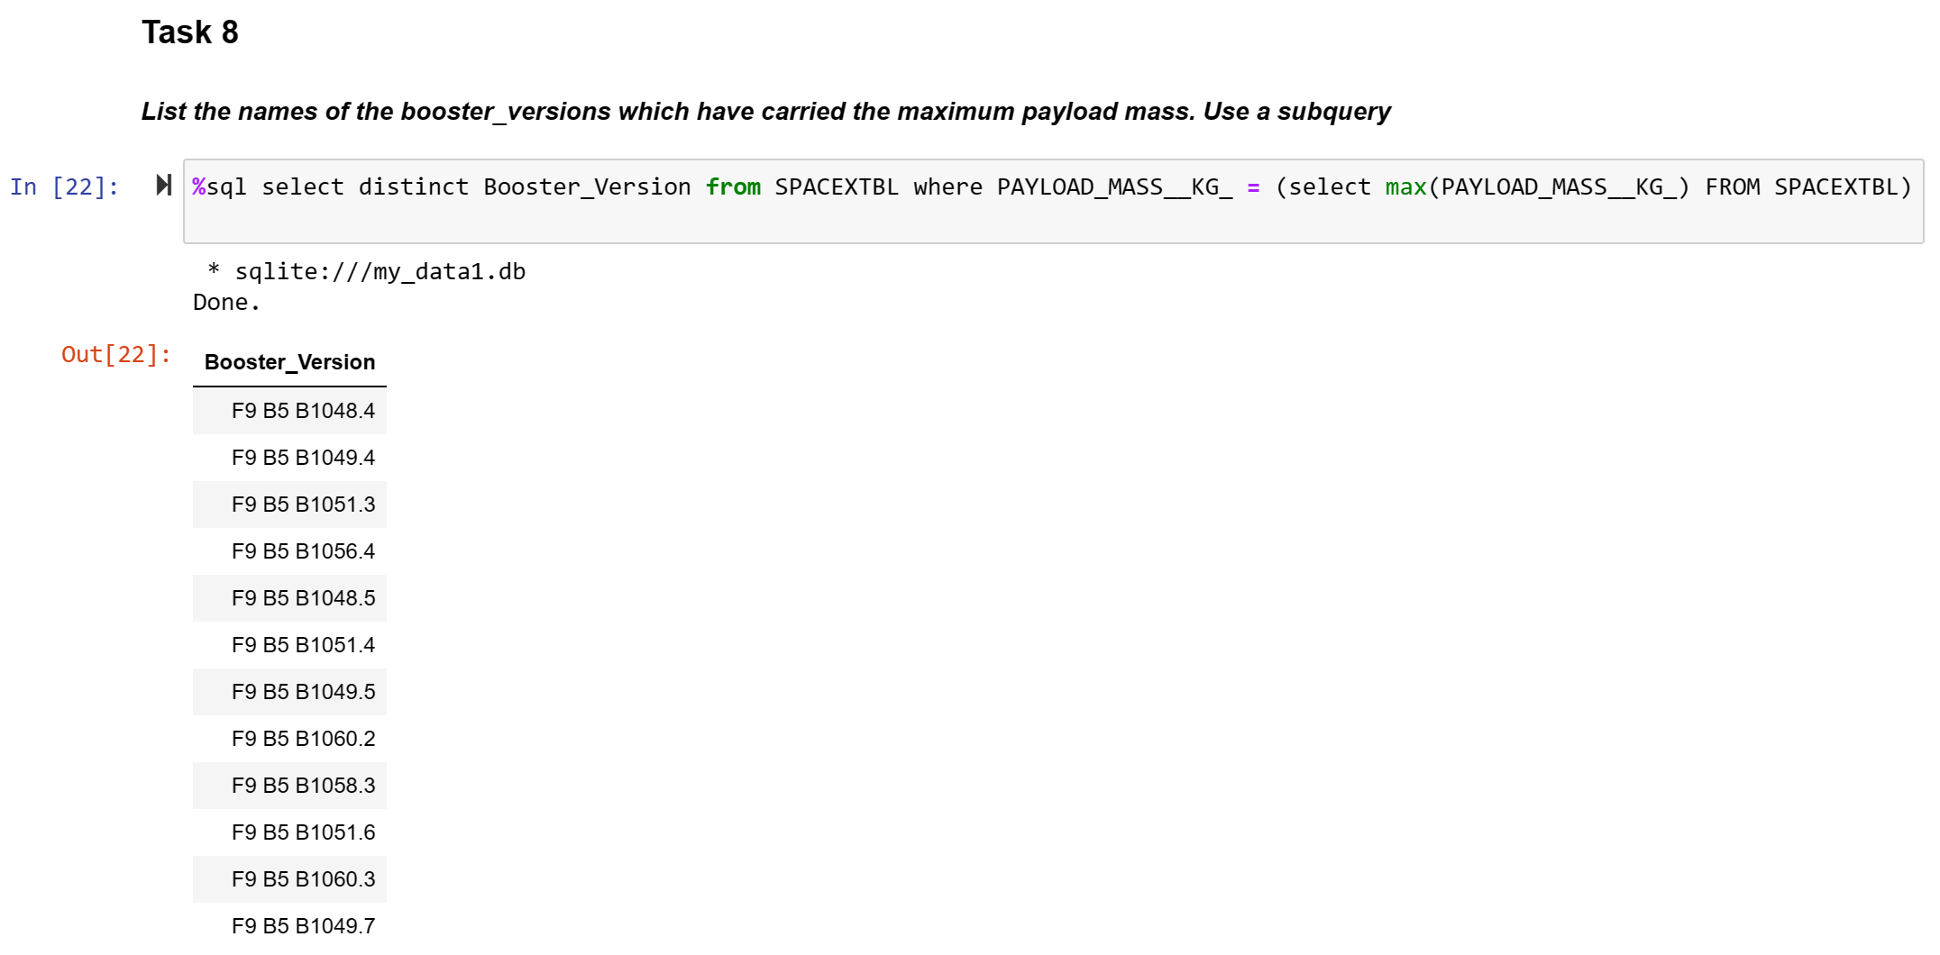
Boosters Carried Maximum Payload
The main query uses subquery results and returns booster version with the heaviest payload mass. The subquery filters data (the heaviest payload mass) by using WHERE function and MAX function.

Slide 32
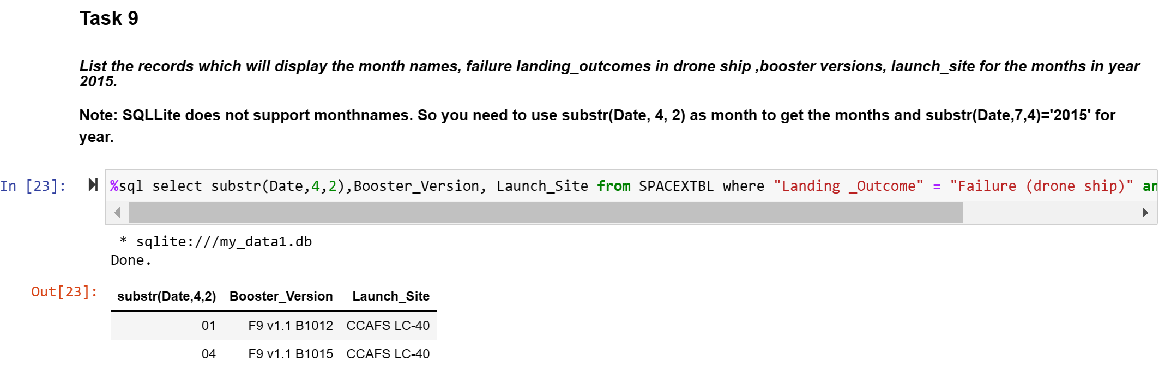
2015 Launch Records
Failed landing outcomes in drone ship, their booster versions, and launch site names for in year 2015

Slide 33
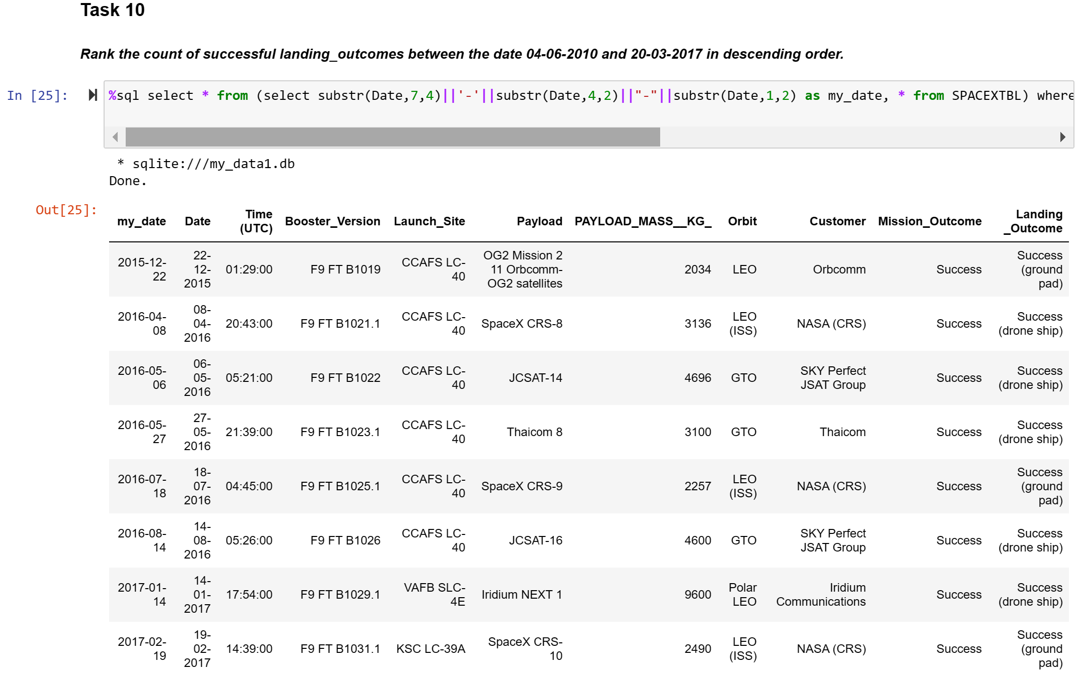
Rank Landing Outcomes Between 2010-06-04 and 2017- 03-20

Slide 34
Section # 3
Launch Sites Proximities Analysis

Slide 35
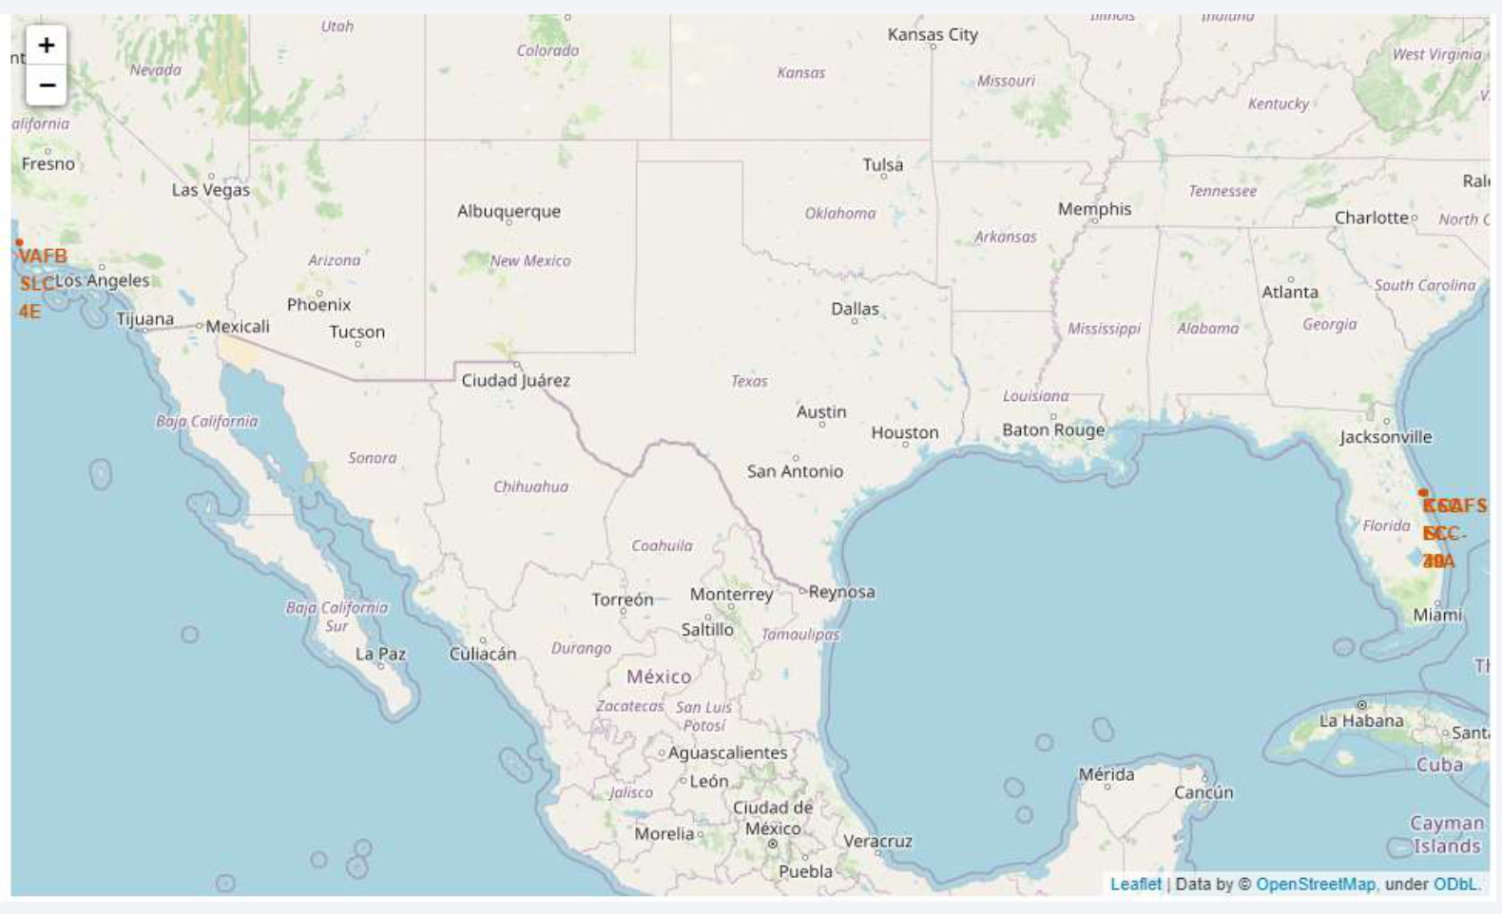
All Launch Site Location
All launch sites are in proximity to the Equator line, and they are very close proximity to the coast

Slide 36
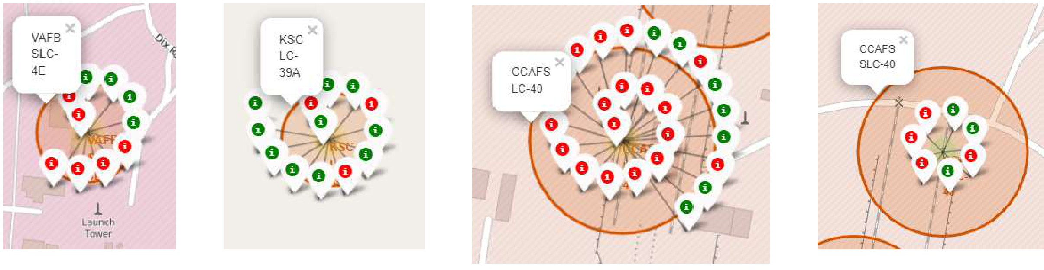
Color-Labeled Markers with Outcomes
Green marker represents successful launch and Red marker represents unsuccessful launch. The launch site which have relatively high success rates is KSC LC-39A.

Slide 37
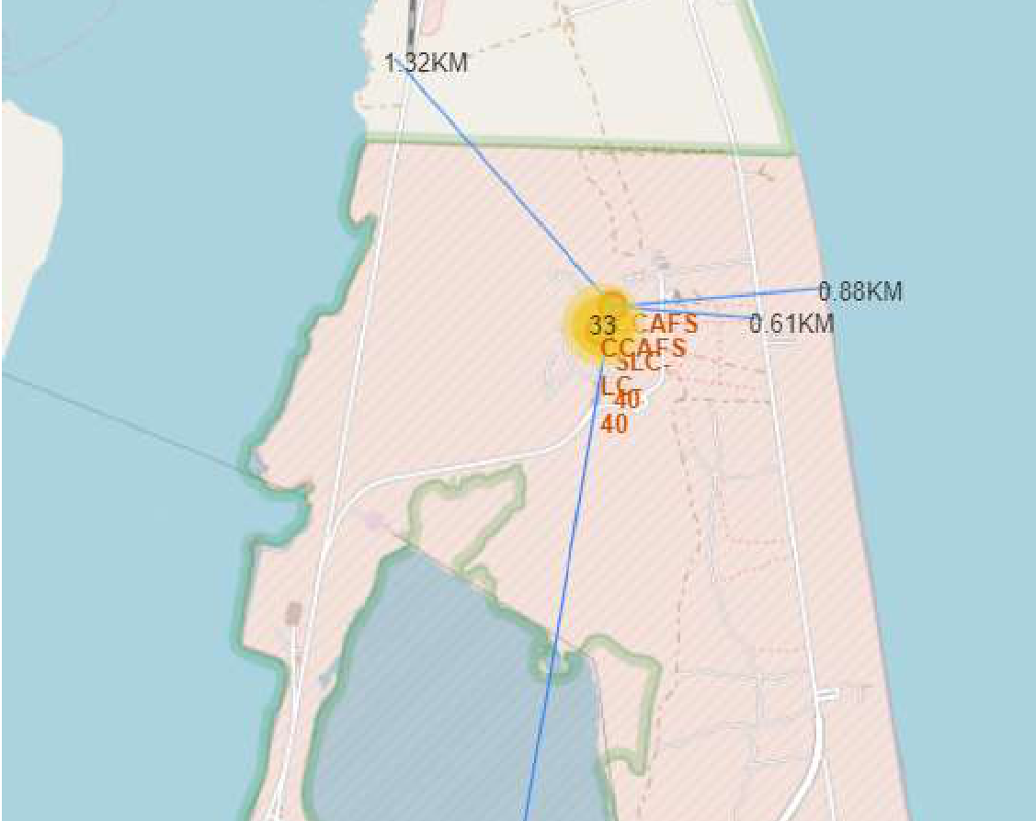
Distances Between CCAFS SCL-40 to its Proximities
CCAFS SCL-40 launch site are near railways (1.32 km), highways (0.61 km) and coastline (0.88 km)
This launch site keep distance away from city such as Melbourne

Slide 38
Section # 4
Build a Dashboard with Plotly Dash

Slide 39
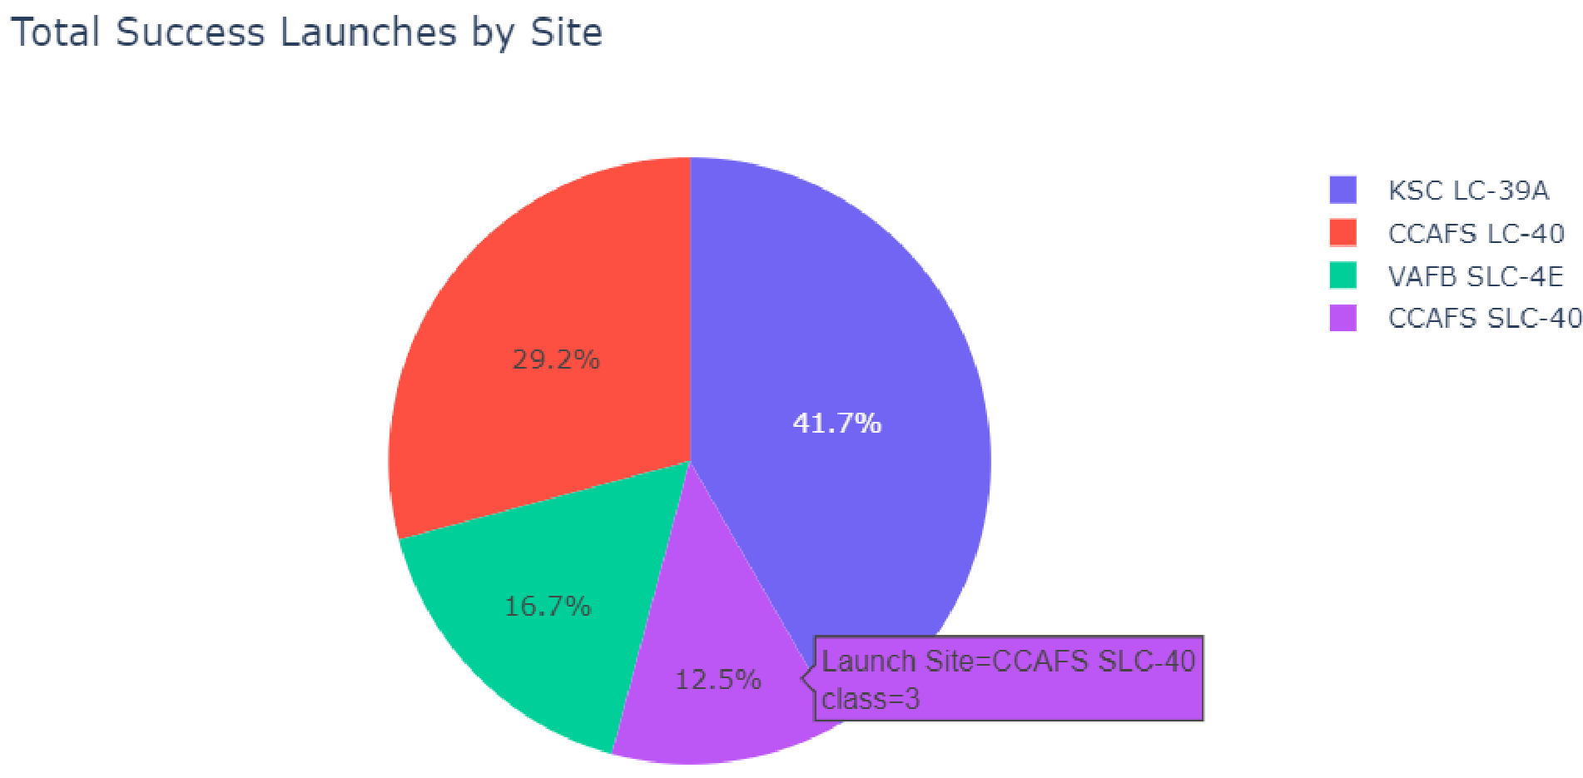
Total launch successes by Launch Site
KSC LC-39A has the highest launch success rate
CCAFS SLC-40 has the lowest launch success rate

Slide 40
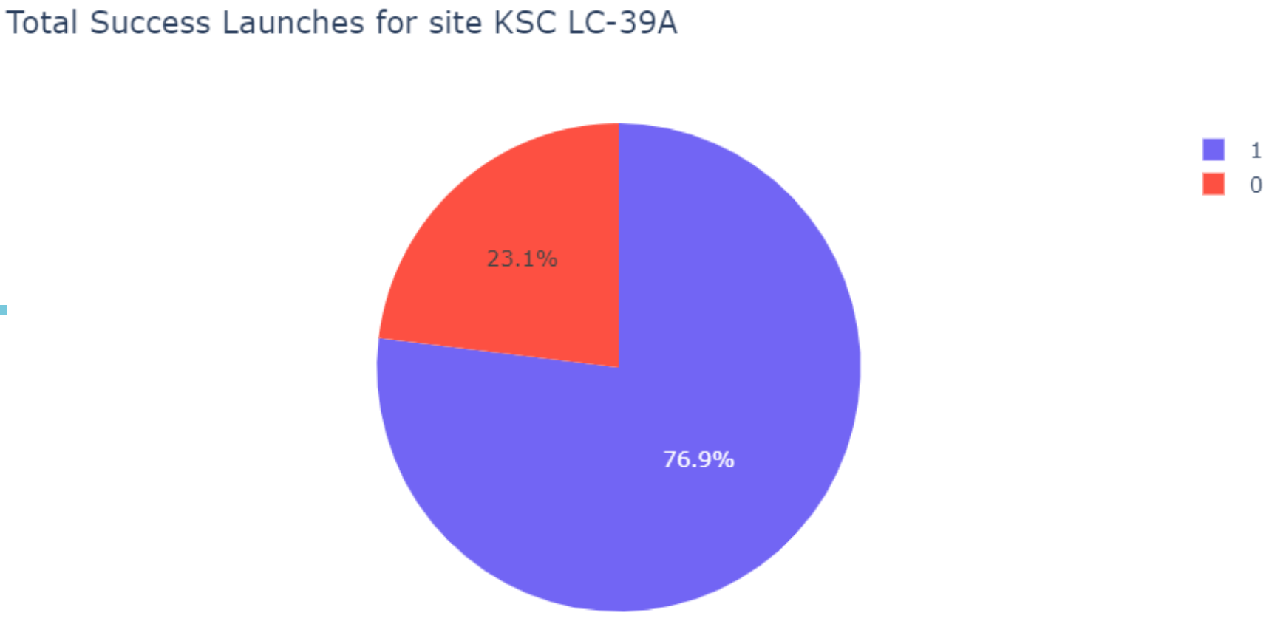
Launch Success rate for KSC LC-39A
KSC LC-39A has achieved 76.9% success rate and 23.1% failure rate

Slide 41
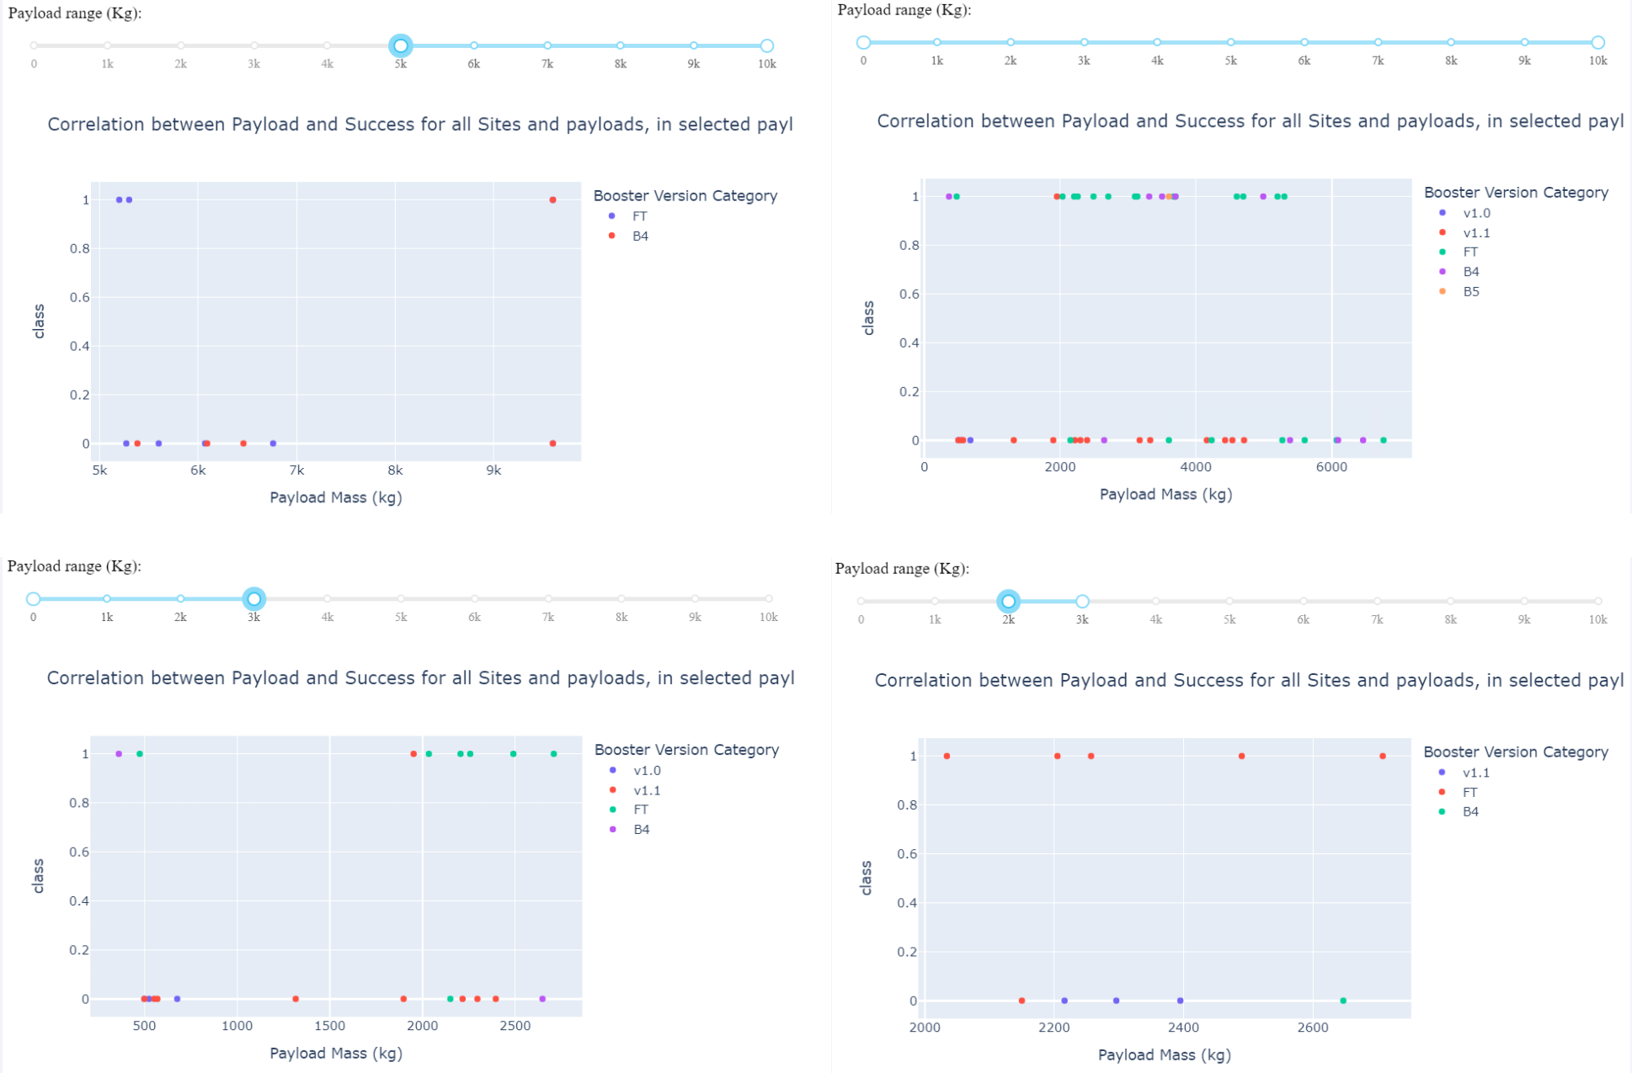
Payload Versus Launch Outcome Across a Range of Payload Ranges
Payload vs. Launch Outcome scatter plot for all sites, with different payload selected in the range slider, overlaid with booster version category
Payload range of 2K-4K has the highest success rate
Booster version of B5 has the highest success rate, followed by B4 version

Slide 42
Section # 5
Predictive Analysis (Classification)

Slide 43
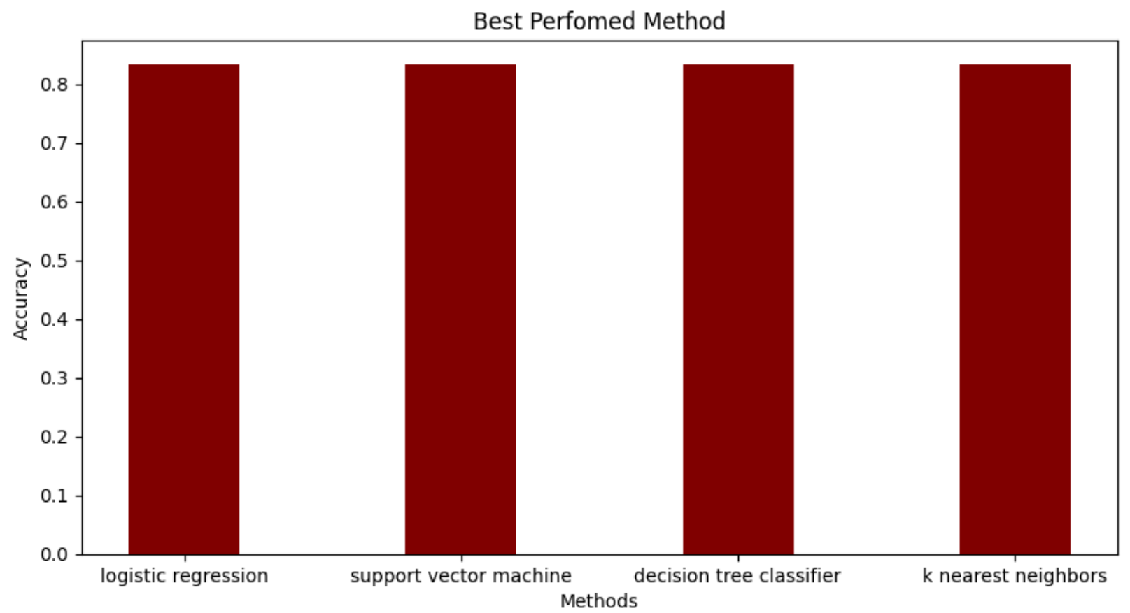
Classification Accuracy
Visualize the built model accuracy for all built classification models, in a bar chart

Slide 44
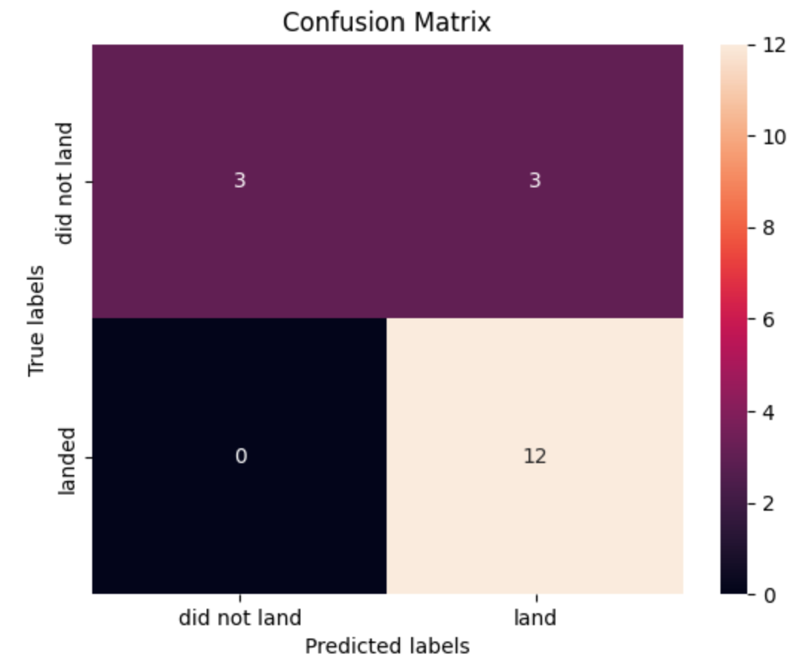
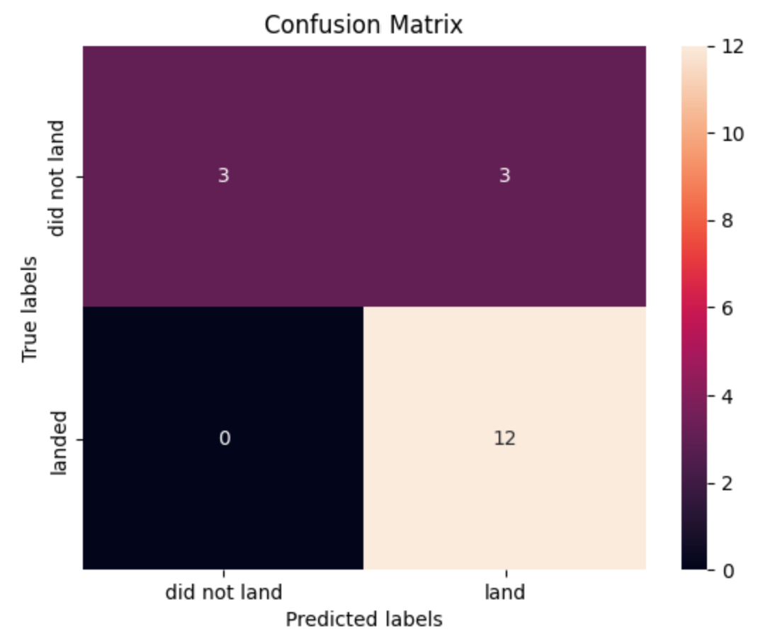
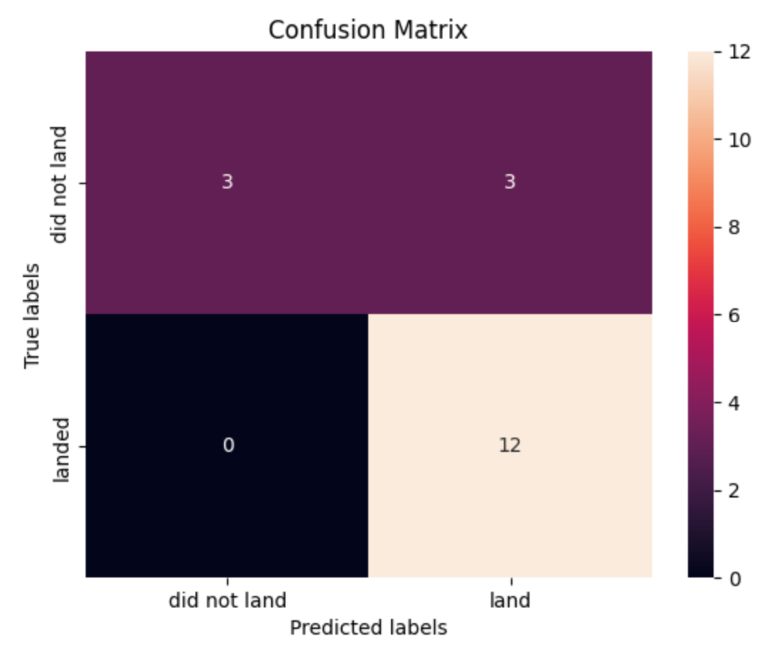
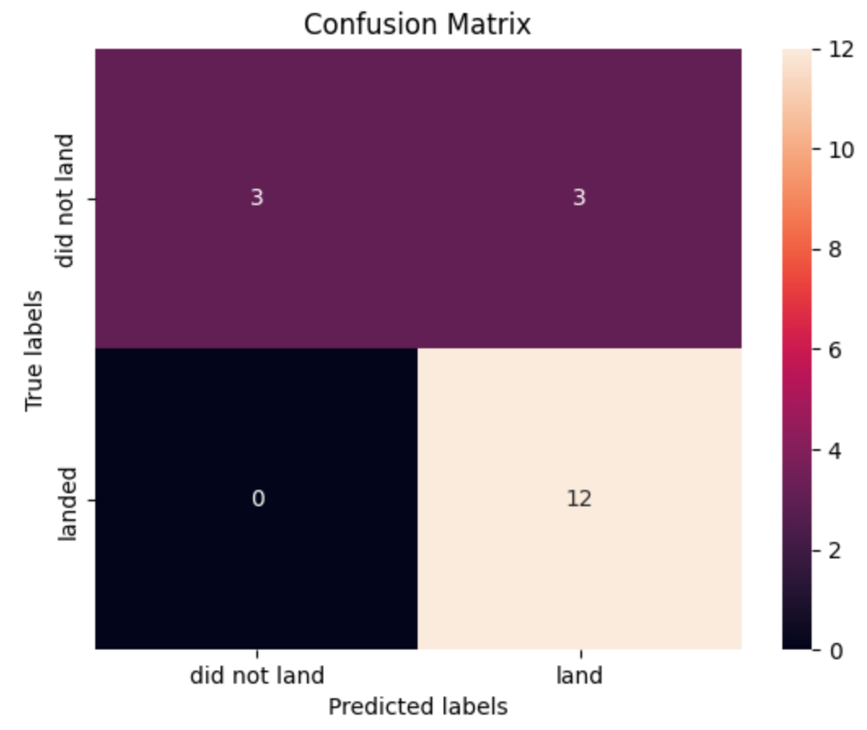
Confusion Matrix
Each methods have the same test accuracy, and the Confusion Matrixes are identical.
logistic Regression
SVM
Decision Tree
KNN

Slide 45

Conclusion
The orbit with the high success rate is ES-L1, GEO, HEO and SSO.
The low weight payload ( 0 – 5000 kg) has the highest launch success rate than the heavy weight payload (5000 – 10000 kg).
SC LC-39A has the highest launch success rate in all the sites which is 76.9%.
All algorithms are good to use as they have identical test accuracy, however the Decision Tree Algorithm is chosen as the best model because it has a better train accuracy.

Slide 46

Appendix
Include any relevant assets like Python code snippets, SQL queries, charts, Notebook outputs, or data sets that you may have created during this project

Slide 47
Thankyou so much

